Slide 1


STOCK DASHBOARD
~ RISHA R. POOJARY
S.20.85

Slide 2
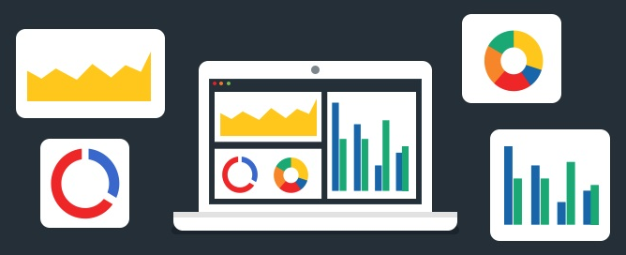
CONTENTS
OBJECTIVE
STEPS
FORMULA
CONCLUSION

Slide 3
OBJECTIVE
To create an interactive dashboard of TCS Stock.
To understand and keep a track of TCS stock (share) price.
It shows daily, monthly, quarterly and yearly value of opening and closing stock price.
To decide whether to BUY/SELL TCS Stocks.

Slide 4
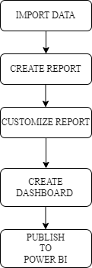
STEPS

Slide 5
FORMULA
DAX function => Date and Time function
Day : Day = DAY('TCS NS'[Date].[Date])
Month : Month = MONTH('TCS NS'[Date].[Date])
Quarter : Quarter = QUARTER('TCS NS'[Date].[Date])
Year : Year = YEAR('TCS NS'[Date].[Date])

Slide 6
CONCLUSION
Power BI tool has been able to drive better representation of TCS stock price for the duration of 30-03-2022 to 29-03-2023, through it’s ability to provide insights in visually impressive and interactive reports.

Slide 7
THANK YOU!
Guided by, Prof. Vrushali Gawali

